Slide 1
PRESENTATION ON PYTHON PROGRAMMING
BY
GAYATHRI S

Slide 2
Introduction To Python
Python is a high-level, interpreted, interactive and object-oriented scripting language which finds its application in many areas like -
Web scripting
3d Modelling (Blender)
Desktop Applications -`Games (Pygame)
Scientific usage (SciPy/NumPy)
Good language to teach programming

Slide 3
FEATURES:
A simple language which is easier to learn
Free and open-source
Portability
Extensible and Embeddable
A high-level, interpreted language
Large standard libraries to solve common tasks
Object oriented
Very powerful and Ubiquitous
Established interface with all major DB's

Slide 4
Reasons to Choose Python as First Language
Simple Elegant Syntax
Not overly strict
Expressiveness of the language- Python allows you to write programs having greater functionality with fewer lines of code.
Great Community and Support-There are numerous active forums online which can be handy if you are stuck which include:
Learn Python sub reddit
Google Forum for Python
Python Questions - Stack Overflow

Slide 5
Technical Features:
Object-oriented (supports both functional and structured programming)
Dynamically and strongly typed
Whitespace delimited (Indentation)
Scripting language which supports large applications.
High-level dynamic data types and supports dynamic type checking
Automatic garbage collection
Interpreted makes compiler interact with developer.
Easy integration with C, C++, COM, ActiveX, CORBA and Java.

Slide 6
Python Implementations:
CPython - Python implementation on standard C language.
Jython - Python implementation with Java virtual machine to blend with Java.
Pypy - Python implemented in Python and its Just-in time compiler making it fastest.
Iron Python - for windows, which implements common runtime libraries to interface with .NET.

Slide 7
Difference between Python 2&3
Print:
Python 2 treats “print” as statement rather a function.
Python 3 explicitly treats “print” as a function.
Integer Division:
Python 2 treats numbers without any digits. (Output of expression 3 / 2 is 1, not 1.5). To get the result 1.5, you would have to write 3.0 / 2.0.
Python 3 evaluates 3 / 2 as 1.5 by default, which is more intuitive for new programmers.
List Comprehension Loop Variables: Common name for the variables that is iterated over in a list comprehension as a global variable get interchanged. This is fixed in Python 3.
Unicode Strings: By default Python 3 stores strings as Unicode unlike Python 2.
Raising Exceptions: Python 3 requires different syntax for raising exceptions.
Python 2:raise IOError, “some error message”
Python3: raise IOError(“some error message”)

Slide 8
Keywords and Identifiers
KEYWORDS
IDENTIFIERS
There are 33 keywords which are case sensitive. All the keywords except True, False and None are in lowercase and they must be written as it is.
General rules for identifiers are applicable here
Identifier can be of any length.
Multiple words can be separated using an underscore or CamelCase Writing, this_is_a_load or ThisIsALoad

Slide 9
Whitespace Indentation & Comments &docstring in Python
Programming languages like C, C++, Java use braces { } to define a block of code. Python uses indentation.
A code block (body of a function, loop etc.) starts with indentation and ends with the first unindented line. General amount of indentation:4whitespaces
In Python, we use the hash (#) symbol to start writing a comment.
If we have comments that extend multiple lines, way of doing this is to use triple quotes, either ''' or "“”
Documentation string is a string that occurs as the first statement in a module, function, class, or method definition. We must write what a function/class does in the docstring.
Docstring is available to us as the attribute __doc__ of the function

Slide 10
Variables & Constants
In Python we don't assign values to the variables, whereas Python gives the reference of the object (value) to the variable.
Variables do not need declaration to reserve memory space. The "variable declaration" or "variable initialization" happens automatically when we assign a value to a variable.
Python is a type inferred language, it can automatically infer (know) the type of a variable
Constants are containers that hold information which cannot be changed later.
Constants are usually declared and assigned on a module. The module means a new file containing variables, functions etc which is imported to main file. Inside the module, constants are written in all capital letters and underscores separating the words. Eg.,
PI = 3.14GRAVITY = 9.8
import constant
print(constant.PI)
print(constant.GRAVITY)

Slide 11
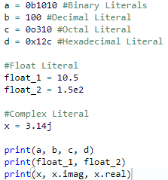
Numeric Literals
Numeric Literals are immutable (unchangeable). Numeric literals can belong to 3 different numerical types Integer, Float and Complex
OUTPUT :10 100 200 300
10.5 150.0
3.14j 3.14 0.0

Slide 12

String Literals & Boolean Literals
A string literal is a sequence of characters surrounded by quotes. We can use both single, double or triple quotes for a string. And, a character literal is a single character surrounded by single or double quotes.
A Boolean literal can have any of the two values: True or False
False. In Python, True represents the value as 1 and False as 0.

Slide 13
DataTypes in Python
Every value in Python has a datatype. Since everything is an object in Python programming, data types are actually classes and variables are instance (object) of these classes. There are various data types in Python. Some of the important types are listed below.
Python Numbers-int,float,complex
List
Tuple
Strings
Set
Dictionary

Slide 14
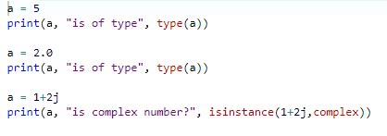
Python Numbers
We can use the type() function to know which class a variable or a value belongs to and the isinstance() function to check if an object belongs to a particular class.
Integers can be of any length, it is only limited by the memory available.
A floating point number is accurate up to 15 decimal places.

Slide 15
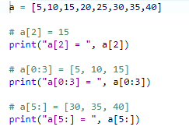
List
List is an ordered sequence of items. It is one of the most used datatype in Python and is very flexible. All the items in a list do not need to be of the same type

Slide 16
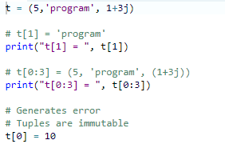
Tuple
Tuple is an ordered sequence of items same as list.The only difference is that tuples are immutable. Tuples once created cannot be modified.Tuples are used to write-protect data and are usually faster than list as it cannot change dynamically.
It is defined within parentheses () where items are separated by commas.

Slide 17
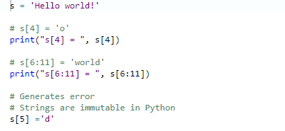
Strings
String is sequence of Unicode characters. We can use single quotes or double quotes to represent strings. Multi-line strings can be denoted using triple quotes, ''' or """.
Like list and tuple, slicing operator [ ] can be used with string. Strings are immutable.

Slide 18
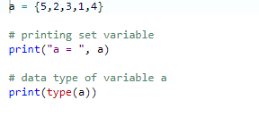
Set
Set is an unordered collection of unique items. Set is defined by values separated by comma inside braces { }. Items in a set are not ordered.
We can perform set operations like union, intersection on two sets. Set have unique values. They eliminate duplicates. Since, set are unordered collection, indexing has no meaning. Hence the slicing operator [] does not work.

Slide 35
THANKYOU

